Slide 1

PALET LOJİSTİK VE DEPOLAMA HİZMETLERİ

Slide 2
Experience in bonded warehouse and a storaging management
Responsibility in customs clearances
Appropriate storage of the goods
Fast and accurate customer services
Cost effective tariffing
Protection and security
Enhanced quality
Strategic partner in the logistics
Expertise in consultancy

Slide 3


OUR PERFORMANCE INDICATORS
Average period FTL offloading = 20 min
Average period partial truck offloading = 15 min
Average period FTL (bulk) offloading = 45 min
Average period for customs report & confirmation = 15 min
Average cycle time of warehousing processes = 60 min

Slide 4
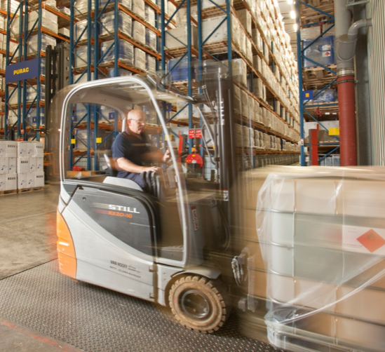
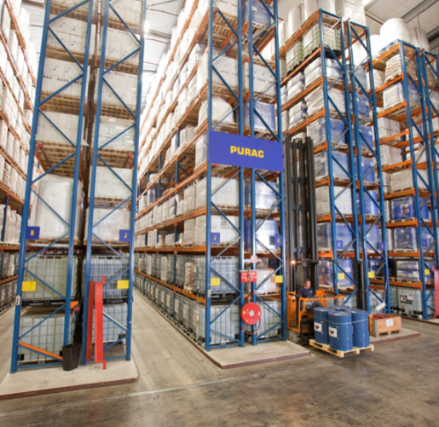
TECHNICAL INFO
Warehouse Operations will be made in Gebze warehouse The details of the warehouse is as follow;
13000 Sqm toal tarea.
3000 Sqm Bonded Warehouse
9500 Sqm Storage
20.000 stocking capasity
8000 Sqm bonded open area.
14 meter height.
24 ramps.
Iso 9001:2008
PEST controlled
Security and monitoring system
Protection and Fire Extinghuiser system
Others Bonded Warehouse Locations;
Halkalı - Kıraç
Ambarlı - Kıraç
Erenköy - Samandıra
Gebze Petro Kimya/ Dilovası
Halkalı temporarily Warehouse

Slide 5

CUSTOM CLEARANCE
Customs clearence operations will be in Erenköy customs with expertise of AB Gümrükleme. Some of the services are;
Customs law and regulations
Import and Export regulations
Import and Export Regime decisions
ATR regulation consultations.
Incentive Regulations consultancy
VAT legislations.
Transit and transfer transactions.

Slide 6

PROCESSES
Operation Process
(Entry)
Warehouse Process
Stocking Process
Operation Process (Exit)

Slide 7
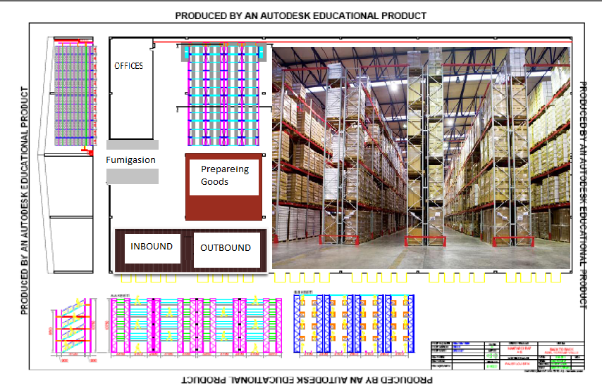

Slide 8
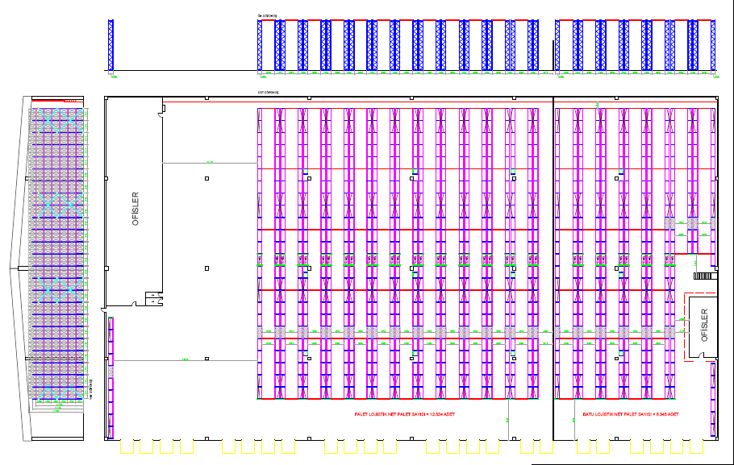
Palet Warehouse
19200 Euro palet capasity
16 mt height
24 Ramps
100 Truck parkings area

Slide 9
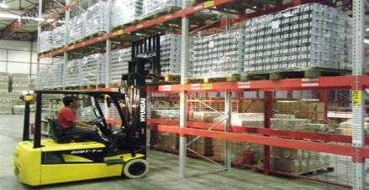
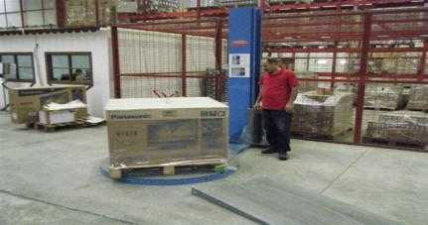
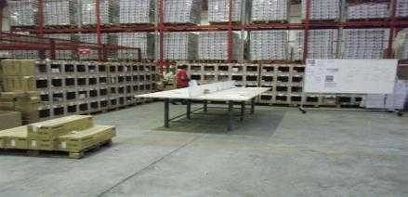
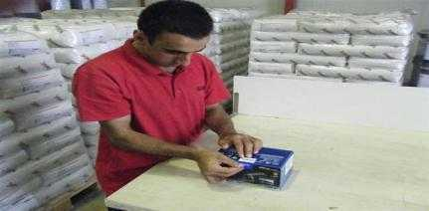
LOGISTICS WAREHOUSE
Value-Added Services; Repackaging, Labelling, Order Preparation.

Slide 10
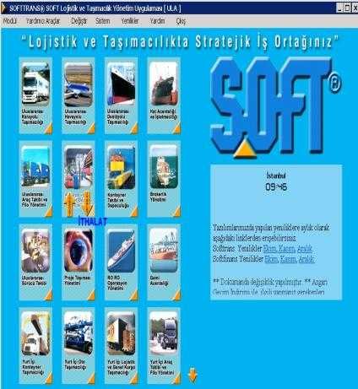
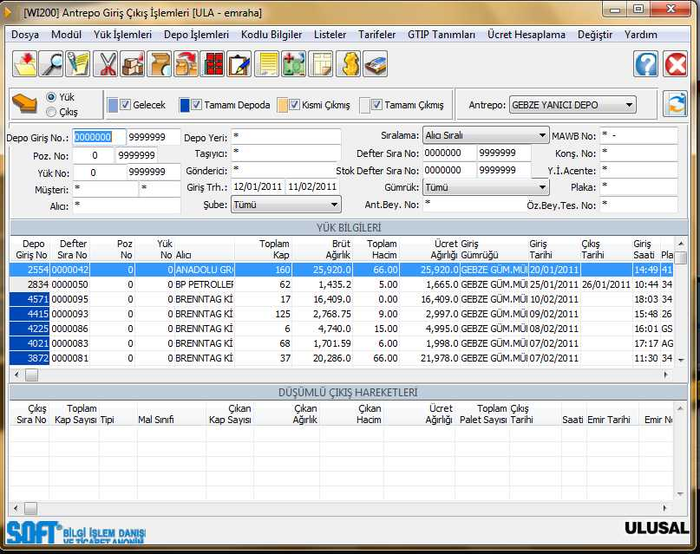
Our Services Reporting & Product Stock Follow-up
IT is suitable for a client account to be watched by clients. That is implemented a user name and apssword on web.
IT is available entegrated to be used an interface implented.
It is watched on online

Slide 11
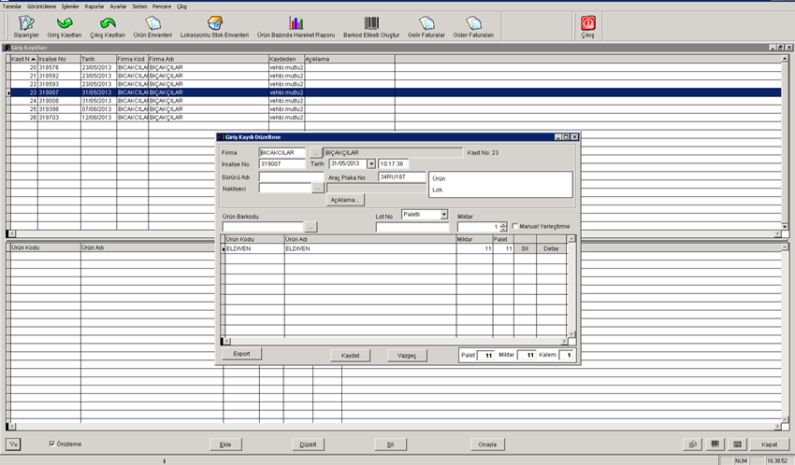
Inbound;
To be used barcoding. IF clients barcodes is not contained a suitable infos , we can preaperad our barcoding.
The barcod has to be given information such as a kg, pallets articles no, type or what clients needs as well.
In entrance, the delivey notes and truck plate number is recorded on a system.
The goods are transfered to the adress by using a hand terminal

Slide 12
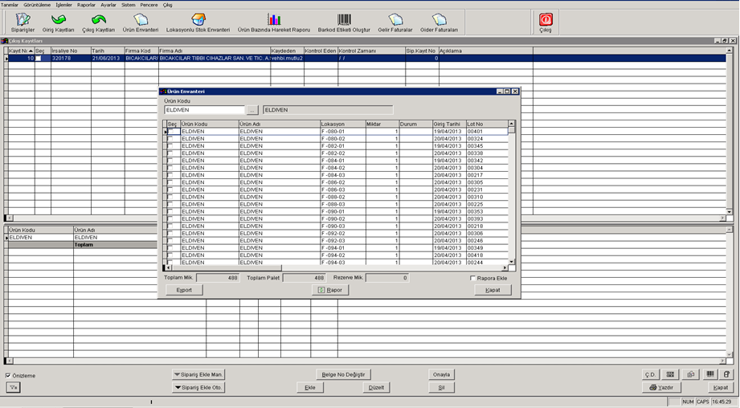
OUTBOUND ; The Company gives a outbound datas. The goods are prepared to delivery.
As the order has been taken, the goods are ready for picking up from the adress, IF Clients gives a XML order data , the orders is shown on the system automaticly.

Slide 13
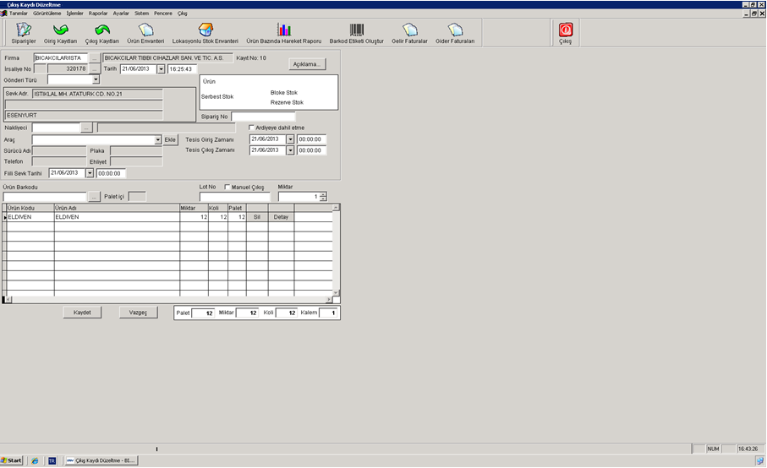
Taken order transaction, the goods are picked the right places, the order is closed by system.
ıf the wrong goods are collected , the system automaticly given a error.
As same as an entrance process ,what is the info about truck plate number, delivery note number entered to the system .

Slide 14
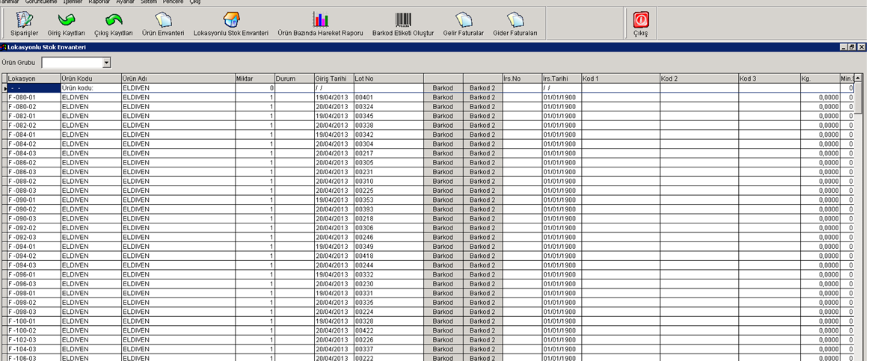
Reporting; The system is given you stocking controll, the report can be preaperad what Clients needs.

Slide 15
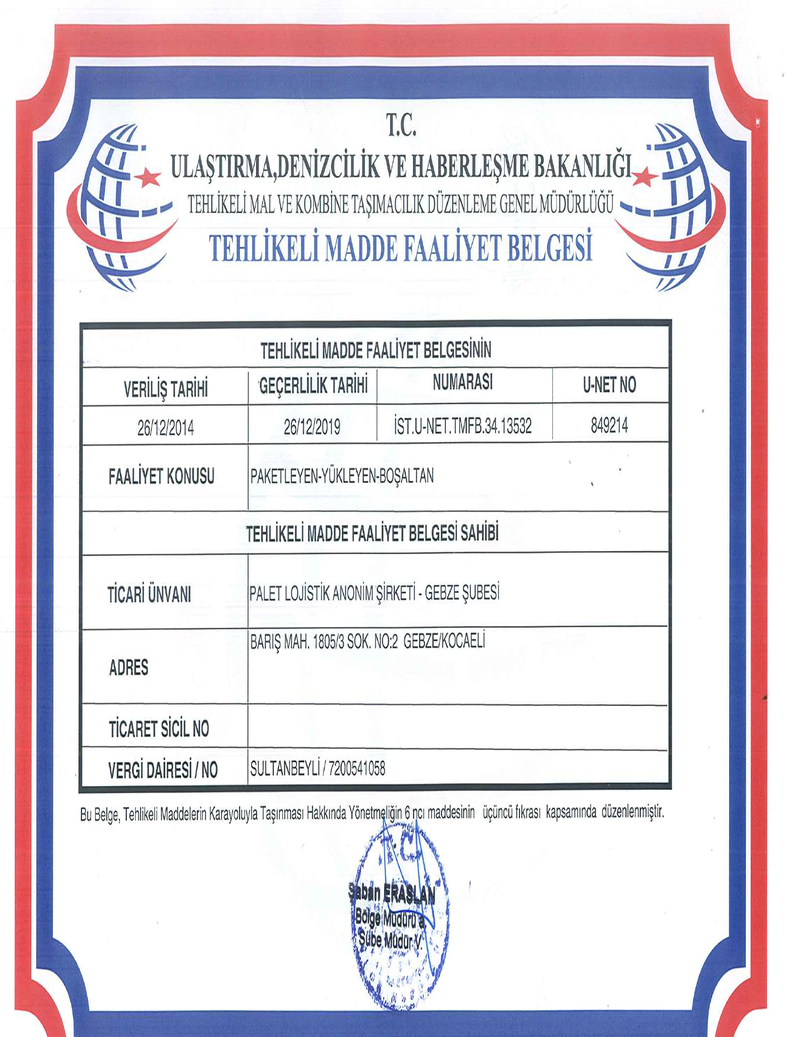
CERTİFİCATE OF DANGEROUS GOODS ACTİVİTY

Slide 16

Thank you

